Slide 1

Project Title - Seasonal Agriculture Performance Analysis
Name:- Jaydev Hirenbhai Bhatt
College Name- A D Patel Institute of Technology
AICTE STU ID : STU6a279c60ae81f1780980832

Slide 2

PROBLEM STATEMENT
Agricultural activities are influenced by seasonal variations in environmental conditions, farming practices, resource availability and market conditions. As a result, agricultural performance may differ from one season to another. However, raw agricultural data does not clearly explain how agricultural performance changes across seasons or what patterns can be observed in different seasonal conditions. The problem is to analyze the given agricultural dataset and investigate seasonal differences in agricultural performance by identifying meaningful patterns, trends, relationships and variations within the available data.

Slide 3
Project Description:- Analyzed 4,000 farm-level records across 8 states, 8 crops, 4 irrigation methods, and 3 cropping seasons — Kharif, Rabi, and Zaid. Studied rainfall, yield, water efficiency, disease/pest risk, cost, revenue, and profit using data cleaning, EDA, correlation, and comparative analysis. Kharif emerged as the most profitable season, with the highest average yield and profit, but also the highest disease/pest risk. Zaid was the weakest-performing season, with 64.5% of farms operating at a loss. Found that crop choice and irrigation method can influence profitability more than season alone. Drip irrigation generated nearly 3× the average profit of Flood irrigation, highlighting the potential of efficient resource management.

Slide 4

WHO ARE THE END USERS?
Farmers — season/crop/irrigation planning decisions
Agricultural Extension Officers / Krishi Vigyan Kendras — advisory guidance
State Agriculture Departments & policymakers — subsidy and planning allocation by season
Banks & crop insurance providers — risk assessment (e.g. flagging Zaid as high-risk)
Agri-input companies (fertilizer, seed, irrigation equipment) — seasonal demand forecasting
Agri-tech startups — building farmer advisory apps on top of this kind of analysis

Slide 5

Technology Used
Python 3
Pandas, NumPy — data cleaning, aggregation, group-wise imputation
Matplotlib, Seaborn — univariate/bivariate/multivariate visualization, heatmaps
Jupyter Notebook / Google Colab — development and documentation environment
Statistical techniques — IQR outlier detection, correlation analysis, pivot-table cross-tabulation

Slide 6
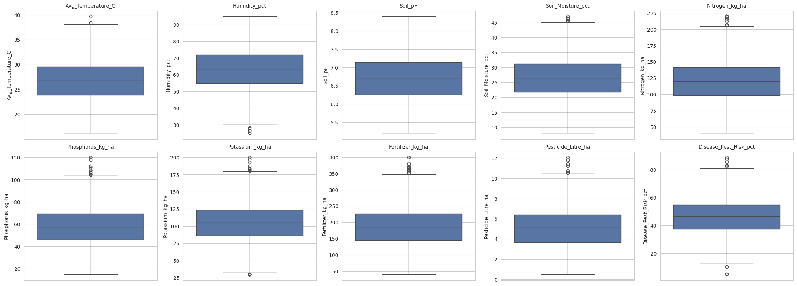
RESULTS

Slide 7
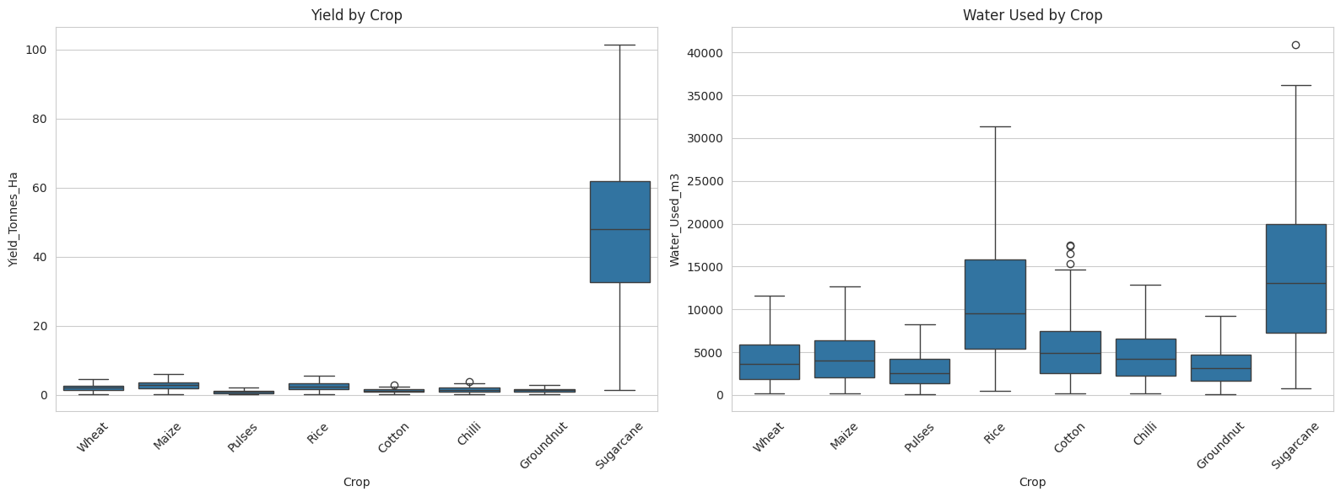
RESULTS
[Add screen shots of your code ]

Slide 8
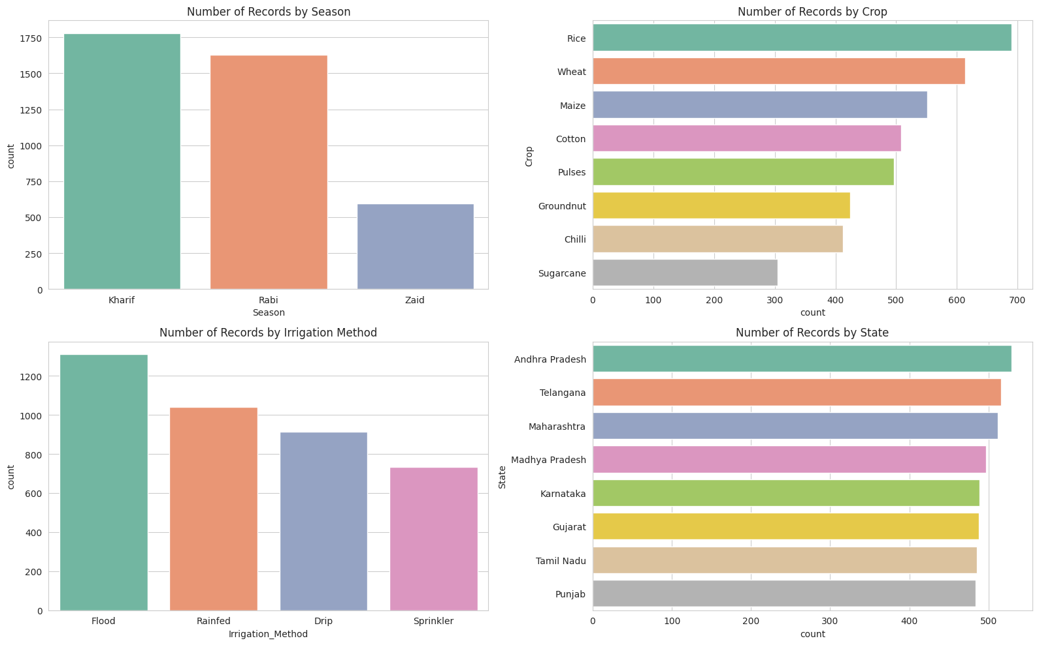
RESULTS
[Add screen shots of your code ]

Slide 9
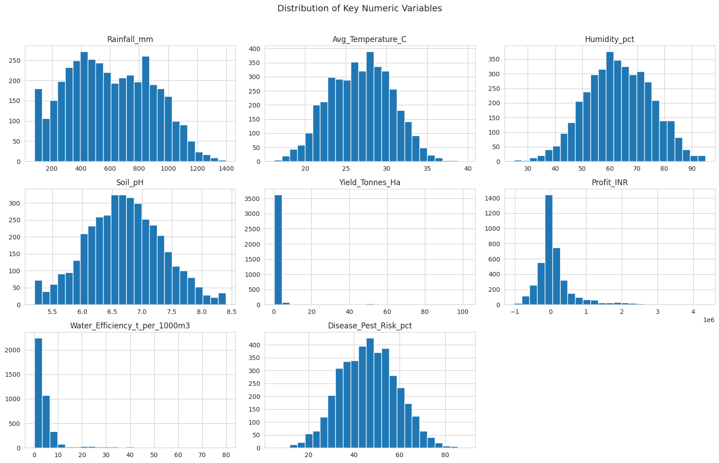
RESULTS
[Add screen shots of your code ]

Slide 10
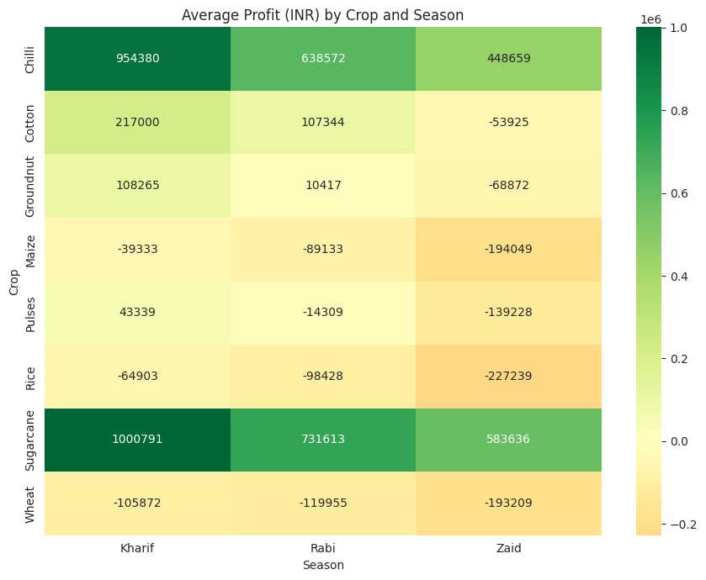
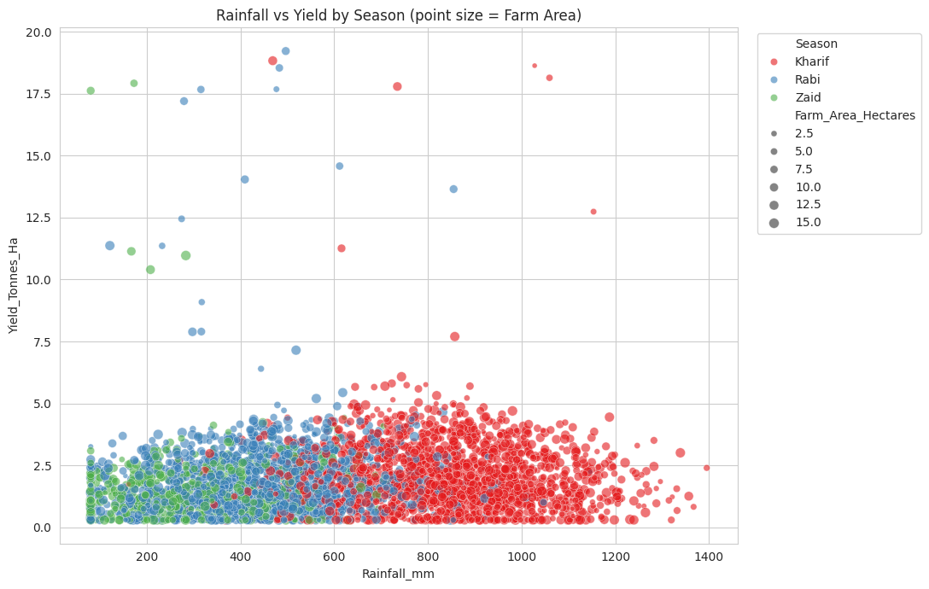
RESULTS
[Add screen shots of your code ]

Slide 11
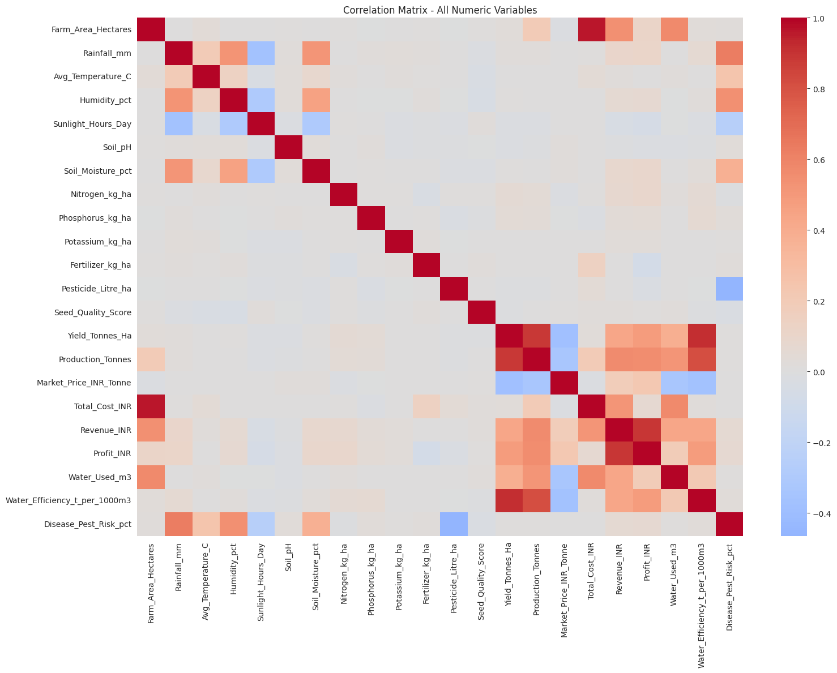
RESULTS
[Add screen shots of your code ]

Slide 12
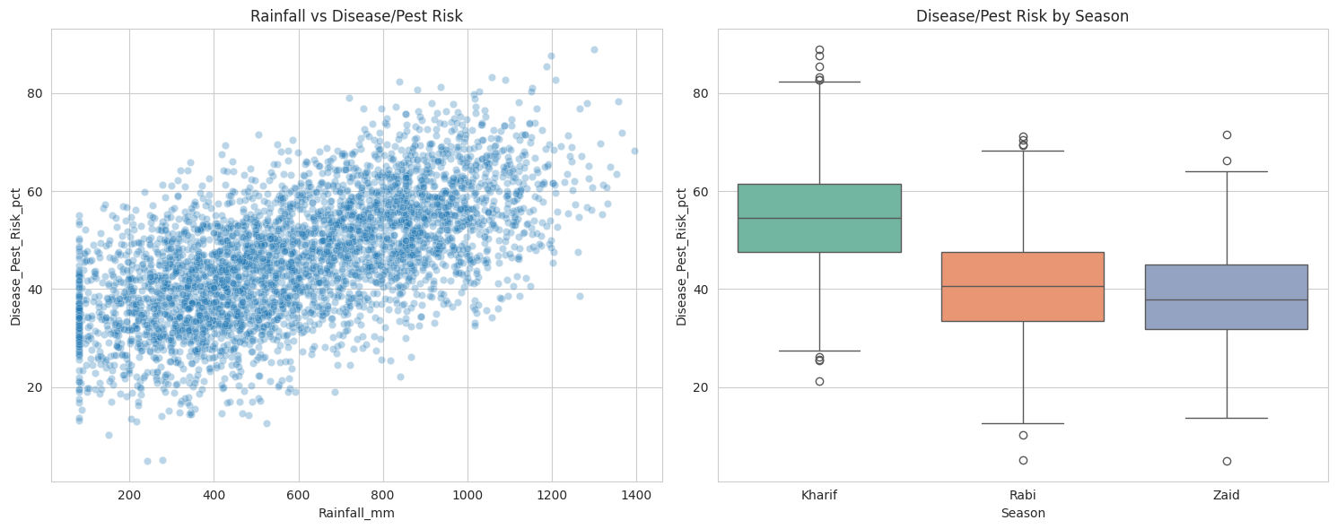
RESULTS
[Add screen shots of your code ]

Slide 13
Future scope
Predictive ML model (regression) to forecast yield/profit from environmental + input features
Live weather API (IMD) integration for real-time seasonal forecasting instead of static data
Crop & irrigation-method recommendation engine tailored to a farm's specific conditions
Interactive dashboard (Power BI / Streamlit) for farmers and policymakers, not just a static notebook
Real, geotagged multi-year data to replace the current single-snapshot, synthetic-geography dataset
Regional-language mobile advisory app built on these insights

Slide 14
GitHub Link
https://github.com/bhattjaydev007-ai/Seasonal-Agriculture-Performance-Data-Analysis-VOIS-Internship-Major-Project

Slide 15
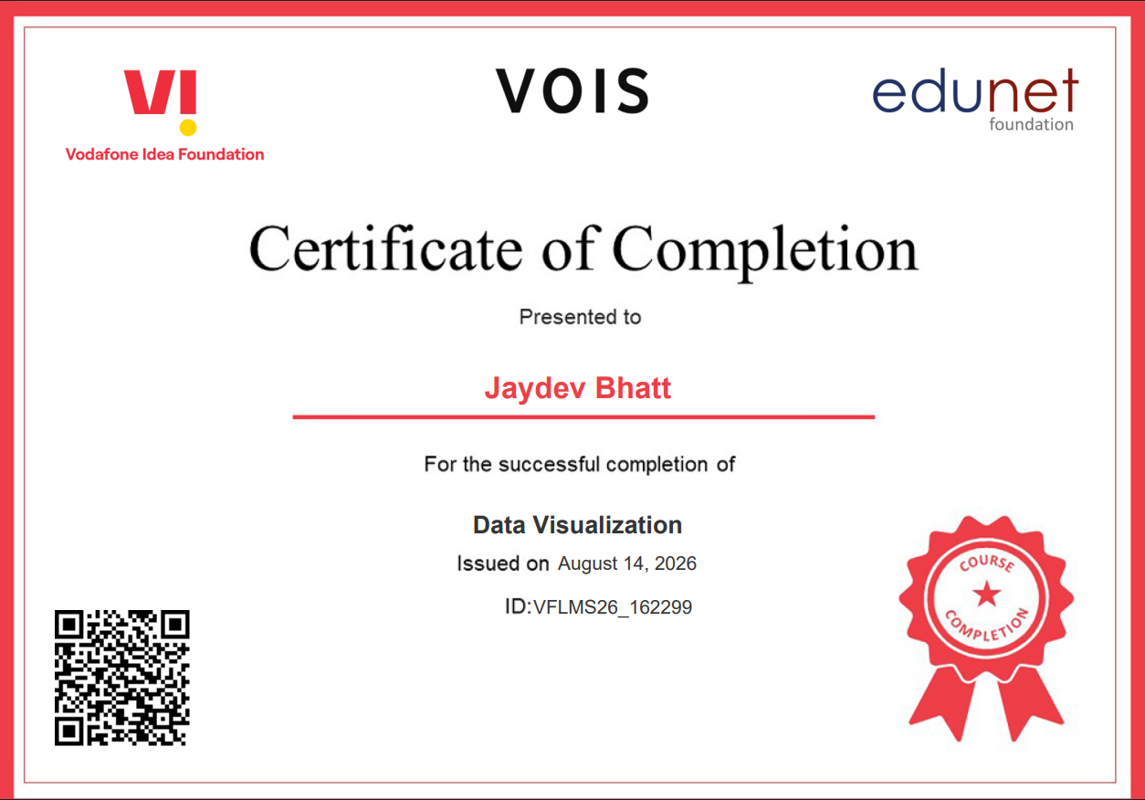
VOIS Course completion certificate - Course name- Data Visualization

Slide 16
Thank you
.
.

